Slide 1
API CI/CD using Devops Platform
Senthil Kumar S

Slide 2
Overview
High Level System View
Proposed Solution
Demo
Sequence of Steps

Slide 3
Overview
Objective
In the current Scenario API Deployment happens via manual process using API Designer
The idea is to minimize manual effort and utilize devops tools to perform continuous integration and delivery of API Connect life cycle
CI/CD Benefits
Consistent and automated way to build, package, and test applications
The CD pipeline automates changes to multiple environments
CI/CD enables more frequent code deployments

Slide 4
High Level System View
TOOLS USED
Jenkins
GitHub
SonarQube
Apache Ant Script
IBM Bluemix/Cloud
API Connect
SOAPUI
Cucumber

Slide 5





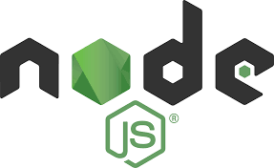


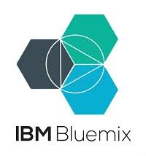
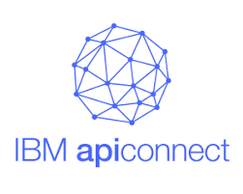
High Level System View

Slide 6
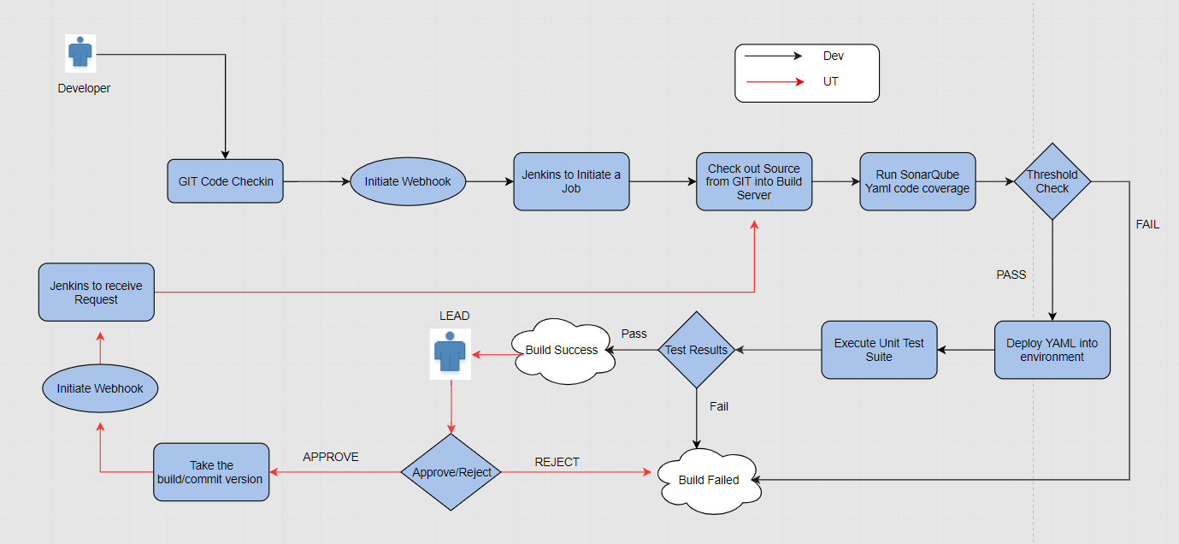
Proposed Solution for API Devops Flow

Slide 7
DEMO
Sequence of Steps
Developer will develop the API locally using APIC toolkit and test it.
Developer Uploads the API Yaml code into Git Repository. For Demo we have two branches (Master and Dev)
Jenkins Build process to be initiated which performs the below steps
Clone code using AntScript from Dev branch into Jenkins workspace
Run code analysis using Sonar Cube (Yaml Plugin used)
Invoke Ant Script to Connect to IBM Cloud and publish the product into API connect Sandbox Catalog .
Trigger unit test cases using SOAPUI/Cucumber to view the results
In case of any failures, Rollback to be performed by pulling the code from Master branch and deploy to cloud

Slide 8
Thank You

